Slide 1

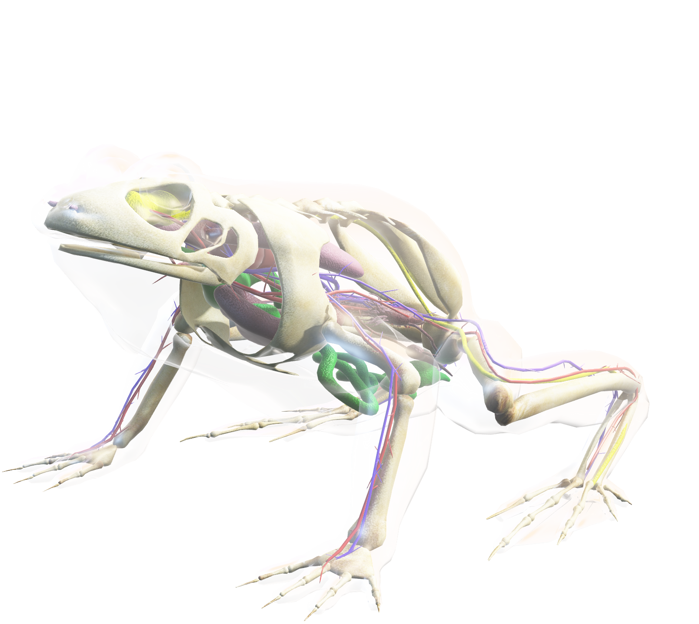
Analysis of Species and Observations in National Parks
Insights into Species Distribution, Conservation Status, and Bat Observations
Bento Poko
24/07/2024

Slide 2

Data Overview
The animal kingdom is very diverse. Each animal has a unique appearance, body structure, and senses, all adapted to the environment where it lives. Their environment is also reflected in the structure of their nervous systems. In this lesson, students will receive a brief overview of the nervous systems of all the types of living animals and observe them on an interactive model.
Species Data
Keywords
Total species entries: 5,824
Unique species: 5,541
Categories: 7 (Mammal, Bird, Reptile, Amphibian, Fish, Vascular Plant, Nonvascular Plant)
Conservation statuses: 4 (Species of Concern, Endangered, Threatened, In Recovery)
Observations Data
Total observations: 3,314,739
National parks: 4 (Great Smoky Mountains National Park, Yosemite National Park, Bryce National Park, Yellowstone National Park)

Slide 3
Conservation Status Analysis
Replaced NaN values in conservation_status with 'No Intervention'
Grouped species based on their conservation status and category
Added is_protected column to indicate conservation status

Slide 4
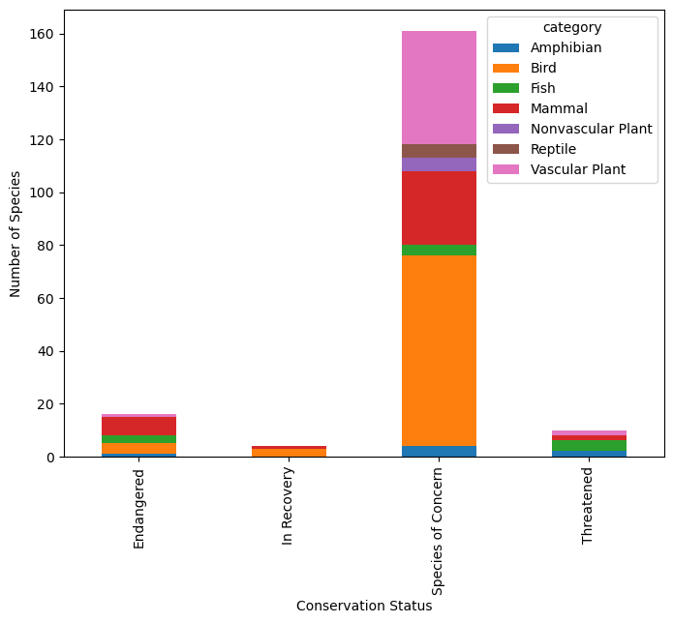
Conservation Status by Category

Slide 5
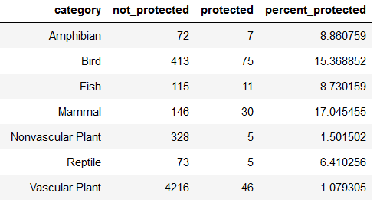
Protection by Category

Slide 6
Significance Testing
Chi-Square Test Results:
Mammals vs. Birds (p-value: 0.688)
Mammals vs. Reptiles (p-value: 0.038)

Slide 7
Recommendations for Conservationists
Focus on categories with significant differences in protection status
Prioritize conservation efforts for reptiles due to significant difference with mammals
Increase monitoring and protection measures for underrepresented categories like vascular plants

Slide 8
Bat Species Analysis
Identified bat species using common names
Merged datasets to get observations related to bat species
Grouped and summed observations by park name and protection status

Slide 9
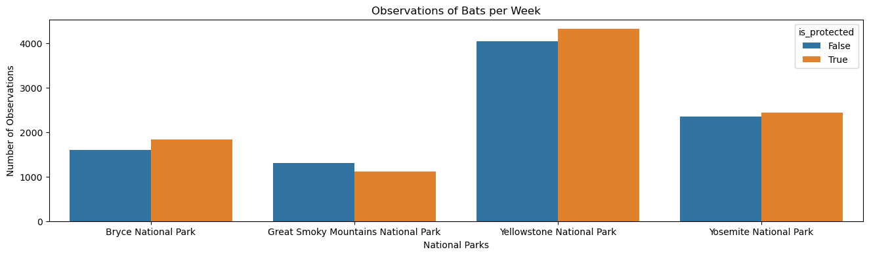
Observations of Bats per Week by National Park

Slide 10
Conclusion
Majority of species do not have any intervention
Mammals and birds have the highest percentage of protected species
Significant differences in protection status between certain categories
Yellowstone National Park has the highest number of bat observations
Recommendations for targeted conservation efforts

Slide 11

Thanks
End

